Slide 1

Notes:
Kotlin je moderní jazyk plně interoperabilní s Javou. Nemusíte se tedy vzdávat vašich Java frameworků ani IDE. A když Kotlin zkusíte, už se k nebudete chtít vracet. Je tu skvělá podpora funkcionálního programování a především čitelnost a expresivita! Buďme upřímní – Java je ukecaná a spousta řádků kódu je jen nutné ceremoniální zlo. Proto vám ukážu jak stručně a elegantně se dá psát v Kotlinu. Zároveň představím několik skvělých vlastností, které si zamilujete. Data classes, Extensins, Null safety a další. Nakonec se podíváme, jak snadno na Kotlin migrovat.
---
Kotlin je moderní jazyk plně interoperabilní s Javou. Nemusíte se vzdávat vašich Java frameworků ani IDE. A když Kotlin zkusíte, už se k nebudete chtít vracet. Je tu skvělá podpora funkcionálního programování a především čitelnost a expresivita!

Slide 2

Martin Müller
Java developer since 2010
adopted Groovy (Spock) testing in 2018
replaced Java with Kotlin in 2019
lives happily ever after with Kotlin & Spock ♥

Slide 3





People and Locations
Prague
Zlín
Hradec Králové
Bratislava
Bucharest
200+ empoyees
Established in 1994
80+ employees
Established in 2007
25+ employees
Established in 2021
90+ employees
Established in 1998
20+ employees
Established in 2016

Slide 4
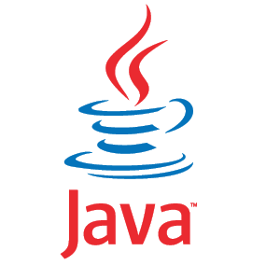









Technologies
Java
Java 11+, Kotlin, Groovy
Spring, JPA, Lombok, Liquibase
Gradle, Spock, Testcontainers
Microsoft Technologies + other
NET: C#, F#, ASP.NET, WPF, .NET MVC, .NET Core, Azure
C, C++, Golang
Microsoft Gold Certified Partner
DevOps
AWS, Azure, Google Cloud Platform
Kubernetes, Docker
Jenkins, GitLab, Bitbucket
ELK stack, New Relic
JS, PHP & Mobile
React, elm, VueJS, Angular, Svelte
NodeJS, PHP (Symfony, Laravel), Drupal 9
ReactNative, Kotlin, SwiftUI,
AI & BI
Power BI, Tableau, Qlik Sense, MS SQL Server, Alteryx, Keboola, Snowflake
Python - TensorFlow, Keras, Pandas, NumPy, SciPy, scikit-learn, Matplotlib
Mechanical Design Engineering
CAD
Parametric 3D modeling
Technical drawings
Testing
Agile Testing
Automation Testing
Manual Testing
Security & penetration Testing

Slide 5


Slide 6
What is Kotlin
Statically typed language for JVM, Android, browser and native

Slide 7
What is Kotlin
Statically typed language for JVM, Android, browser and native
Developed by JetBrains, recommended by Google for Android

Slide 8
What is Kotlin
Statically typed language for JVM, Android, browser and native
Developed by JetBrains, recommended by Google for Android
Similar to Java, less boilerplate code, more readable code

Slide 9
What is Kotlin
Statically typed language for JVM, Android, browser and native
Developed by JetBrains, recommended by Google for Android
Similar to Java, less boilerplate code, more readable code
Can be used together with Java and all Java tools and frameworks

Slide 10
Functions
// Java public int sum(int a, int b) { return a + b; }
// Kotlin fun sum(a: Int, b: Int): Int { return a + b }
Notes:
keyword fun
first name then type
no need for return
return data type inferred

Slide 11
Functions
// Java public int sum(int a, int b) { return a + b; }
// Kotlin fun sum(a: Int, b: Int): Int { return a + b }
fun sum(a: Int, b: Int): Int = a + b
fun sum(a: Int, b: Int) = a + b
Notes:
keyword fun
first name then type
no need for return
return data type inferred

Slide 12
Named arguments
fun build(title: String, width: Int = 800, height: Int = 600) {
Frame(title, width, height)
}

Slide 13
Named arguments
fun build(title: String, width: Int = 800, height: Int = 600) {
Frame(title, width, height)
}
build("PacMan", 400, 300)
build(title = "PacMan", width = 400, height = 300)
build(width = 400, height = 300, title = "PacMan")

Slide 14
Default values
fun build(title: String, width: Int = 800, height: Int = 600) {
Frame(title, width, height)
}

Slide 15
Default values
fun build(title: String, width: Int = 800, height: Int = 600) {
Frame(title, width, height)
}
build("PacMan")
build("PacMan", 400)
build("PacMan", height = 300)
// still the same method, no method overloading needed

Slide 16
Variables
val a: String = "A" // val is unmodifiable
val b = "B" // type can be omitted
var c = "C" // var is modifiable
c = "CC"

Slide 17
Null safety
var a: String = "abc"
a = null // compile error - not nullable type
var b: String? = "xyz"
b = null // no problem

Slide 18
Null safety
val c: String? = "xyz"
val x = c.length // compile error: c might be null
if (c != null) {
val x = c.length // no problem
}

Slide 19
Null safety
val c: String? = "xyz"
val x = c.length // compile error: c might be null
if (c != null) {
val x = c.length // no problem
}
val x = if (c != null) c.length else null
val x = c?.length
val x = c?.length ?: 0 // 0 instead of null on the output

Slide 20
Null safety
val c: String? = "xyz"
val x = c.length // compile error: c might be null
if (c != null) {
val x = c.length // no problem
}
val x = if (c != null) c.length else null
val x = c?.length
val x = c?.length ?: 0 // 0 instead of null on the output

Slide 21
Safe call operator
// Java
public String getZipCode(User user) {
if (user != null && user.getAddress() != null) {
return user.getAddress().getZipCode();
}
return null;
}

Slide 22
Safe call operator
// Java
public String getZipCode(User user) {
if (user != null && user.getAddress() != null) {
return user.getAddress().getZipCode();
}
return null;
}
// Kotlin
fun getZipCode(user: User?) = user?.address?.zipCode

Slide 23
Null safety
fun addOne(list: List<Int>?): List<Int> =
if (!list.isNullOrEmpty()) list.map { it + 1 } // list can't be null
else emptyList()

Slide 24
Scope Function
data?.let{ logger.info ( "Doing my stuff" ) callExternalService(data) }
return getSessionFactoryBase(config).apply { setPassword(config.password) }

Slide 25
When expression
when (x) {
1 -> print("One")
2, 3 -> print("Two or Three")
in 5..10 -> print("is 5 to 10")
else -> print("unknown")
}

Slide 26
When expression
val res = when(x) {
null -> false
is Long -> x > 0
is String -> x.length > 0 // smart cast used here
else -> throw IllegalStateException()
}

Slide 27
Extension functions
fun String.toCamelCase(): String = this.replace(...)
// effectively adding new method to Java String
"hello word".toCamelCase()

Slide 28
Extension functions
// standard library extension functions:
"hello word".reader().forEachLine { ... }

Slide 29
Extension functions
// standard library extension functions:
val file: File = File("readme.txt") val writer = file.bufferedWriter() file.writeText("simple")

Slide 30
Collections
// Java
list.stream()
.filter(number -> number > 0)
.collect(Collectors.toList());
// Kotlin
list.filter { it > 0 }

Slide 31
Collections & extension
operator fun List<Int>.times(by: Int): List<Int> { return this.map { it * by } } val foo = listOf(1, 2, 3) * 4 // [4, 8, 12]

Slide 32
Classes
class Person(
val name: String,
var email: String,
var age: Int
var title: String = ""
) {
fun greet() {
print("Hello, here $name")
}
}
Notes:
Definition of fields = Primary constructor
Can be secondary as well. Must always call primary

Slide 33
Classes
class Person(
val name: String,
var email: String,
var age: Int
var title: String = ""
) {
fun greet() {
print("Hello, here $name")
}
}
val john = Person("John", "john@gmail.com", 112)
val john = Person(name = "John", email = "john@gmail.com", age = 112)
val john = Person(name = "John", email = "john@gmail.com", age = 112, title = "Dr")
Notes:
Definition of fields = Primary constructor
Can be secondary as well. Must always call primary

Slide 34
Inheritance
open class Shape {
open fun draw() { /*...*/ }
fun fill() { /*...*/ }
}
class Circle : Shape() {
override fun draw() { /*...*/ }
}

Slide 35
Singleton
object MySingleton {
fun doSomething() {}
}

Slide 36
Data classes
data class Person(
val name: String,
val email: String,
val age: Int
)

Slide 37
Data classes
data class Person(
val name: String,
val email: String,
val age: Int
)
val john = Person("John", "john@gmail.com", 50)
val john2 = Person("John", "john@gmail.com", 50)
val johnson = Person("Johnson", "johnson@gmail.com", 20)
john == john2 // true
john == johnson // false

Slide 38
Data classes
val jack = Person(name = "Jack", age = 1)
val olderJack = jack.copy(age = 2)

Slide 39
Data classes
val jack = Person(name = "Jack", age = 1)
val olderJack = jack.copy(age = 2)
val jane = Person("Jane", 35)
val (name, age) = jane // destructuring declaration
println("$name, $age years of age") // prints "Jane, 35 years of age„

Slide 40
Data classes
val jack = Person(name = "Jack", age = 1)
val olderJack = jack.copy(age = 2)
val jane = Person("Jane", 35)
val (name, age) = jane // destructuring declaration
println("$name, $age years of age") // prints "Jane, 35 years of age"
println(jane) // data class implements toString

Slide 41
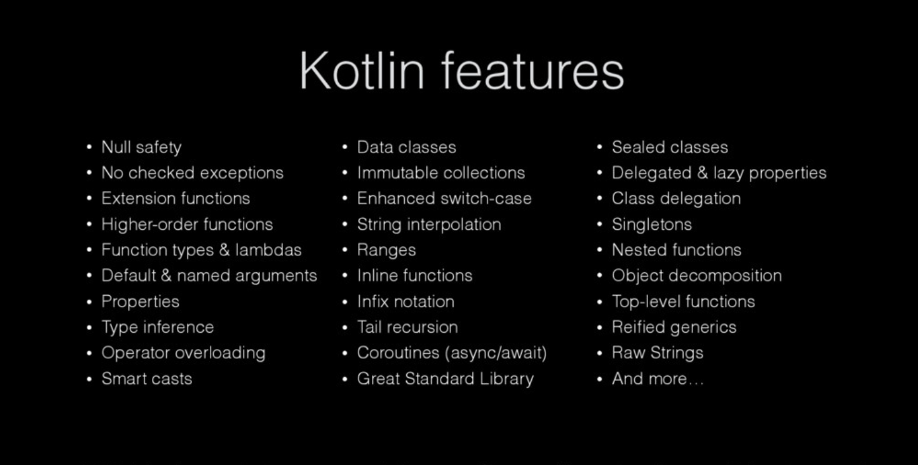

Slide 42
Demo
Java -> Kotlin using IntelliJ
Gradle
scratch files (prototyping, playground)
Kotlin Bytecode (see Java code equivalent)
Spring, JPA, Lombok plugins

Slide 43
Demo
Check project Wishlist to compare
Java & JUnit
Kotlin & Spock
(simple Spring Boot app with Hibernate and REST API)

Slide 44

What else?
Pod Vocasem
Funkcionální programování v Javě
Artificial Intelligence v recruitmentu, Azure Cloud a Kotlin
Speaker’s Corner
Spock: Test Fast & Prosper!

Slide 45

Try Spock as JUnit & Mockito replacement! (link)

